Slide 1


DOCTOR’S APPOINTMENT APP
Group Members -
Jitendra Patil
Ajay Yadav
Prashant Walunj
Dipti Shindekar

Slide 2
WHAT IS HUMAN COMPUTER INTERACTION (HCI) ?

Slide 3
OBJECTIVES
To help to reduce the waiting time of the patient.
To select the appointment time according to user preference.
To reduce complexity of appointment procedure.

Slide 4
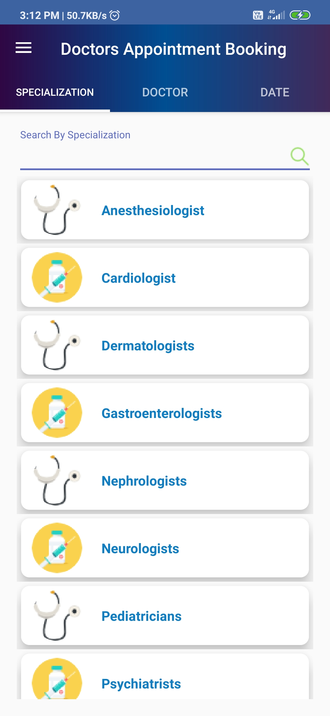
ERGONOMICS
1. Arrangement of Controls and Display
All the options for different doctors and their field specialization along with free time slots.
Users must be able to quickly book an appointment with a specific doctor with the time slot available.
Users can view their appointment details and can choose time for their visit.

Slide 5
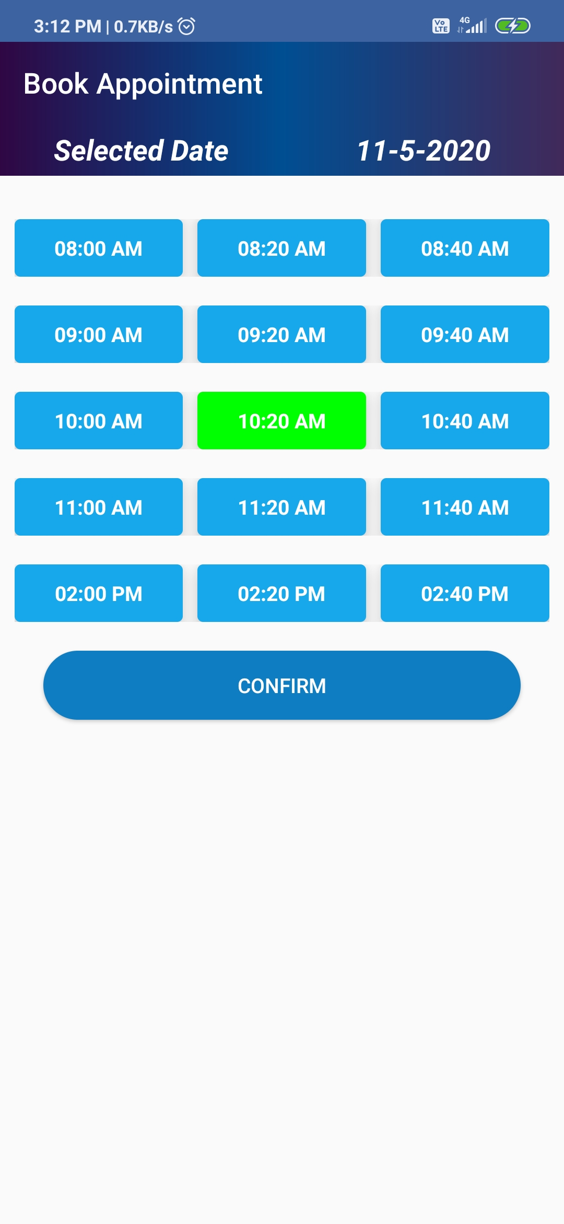
2. Physical Environment of the Interaction
Physical Position :- users need not to type unnecessarily as details of doctors around will be fed from the developer’s side.
Temperature :- User will be mostly using the app at normal surrounding or room temperature , except in extreme conditions.
Lighting :- Normal Smartphone display screen brightness is needed.
Time :- Since the schedule of usage is of fixed nature i.e.. Morning, afternoon , evening and night, one would not spend abnormal hours in the app.

Slide 6
3. Use of color
Choice of color is blue ,white and yellow.
Dark shaded colours so that the functions will be easily visible to the user in all possible conditions.
4. Interaction Styles
Users can interact with the app using their hands like they use any other app.
Can use the app at any time of the day, in any mood the user is.

Slide 7
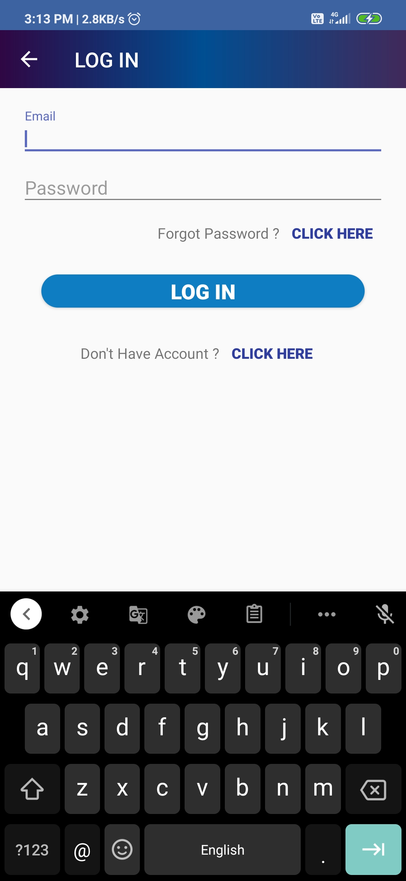
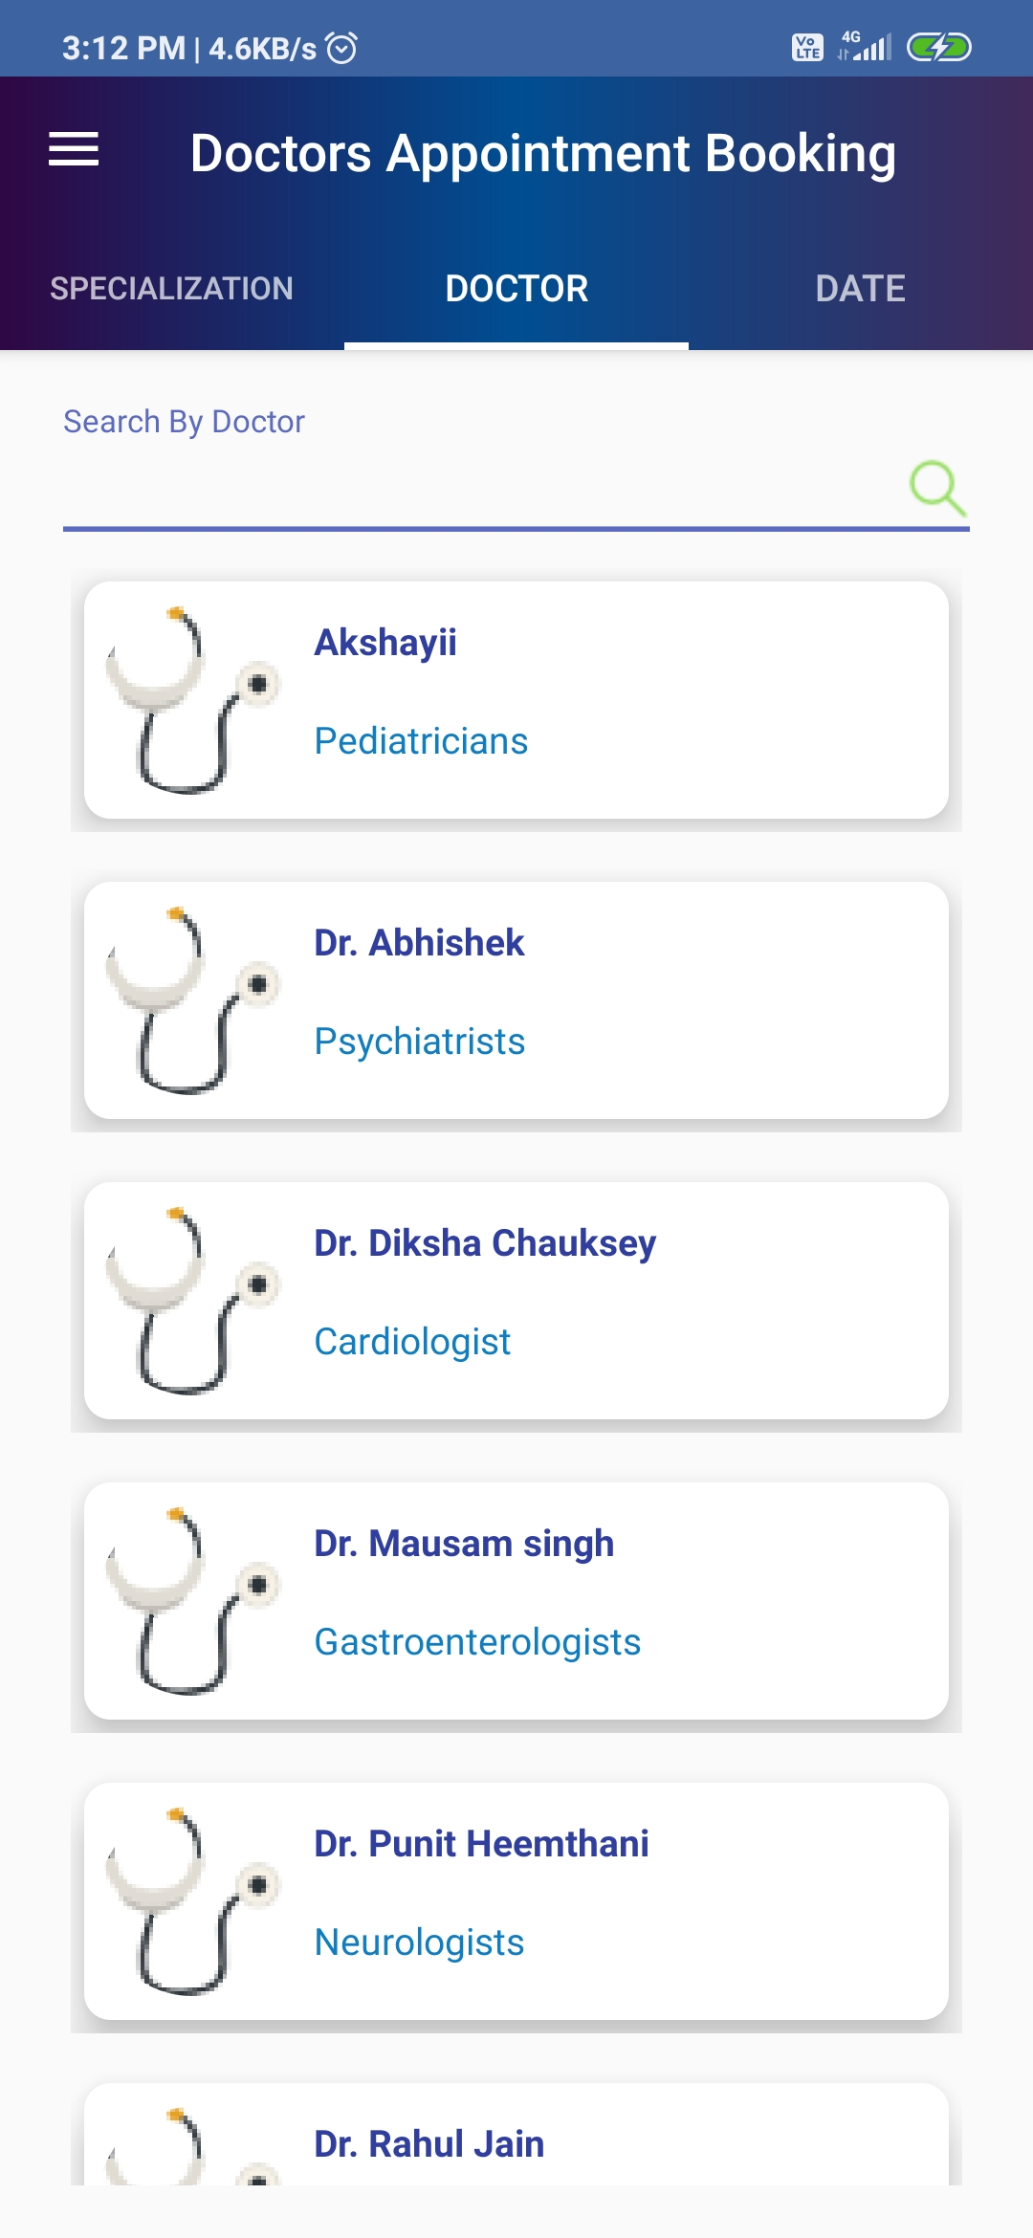

Slide 8
PERSONA.1
Name : Mrs. Pradnya Gawde
Age: 25 Gender: Female ; Occupation: House wife.
Que :
1. How often do you fall sick? - Once or twice in six months
2. How often do you visit a physician for a check-up? - Every time I fall sick
3. How much would you pay for a visit to a doctor? - Rs. 400
4. What kind of a phone are you using? - Smartphone
5. Do you use any social media platforms? - WhatsApp
6. How would you want to be notified about your appointment with the
doctor? - App Notification linked to the Calendar to give me a reminder
7. Do you currently use any app to book an appointment with a doctor? -
No

Slide 9
PERSONA.2
Name : Mr. Mohan Joshi
Age: 32 Gender: Male ; Occupation: Software Developer
Que :
1. How often do you fall sick? - Twice or thrice in year.
2. How often do you visit a physician for a check-up? - Every time I fall sick.
3. How much would you pay for a visit to a doctor? - Rs. 550
4. What kind of a phone are you using? - Smartphone
5. Do you use any social media platforms? – WhatsApp, Instagram.
6. How would you want to be notified about your appointment with the
doctor? - Calls.
7. Do you currently use any app to book an appointment with a doctor? -
No

Slide 10
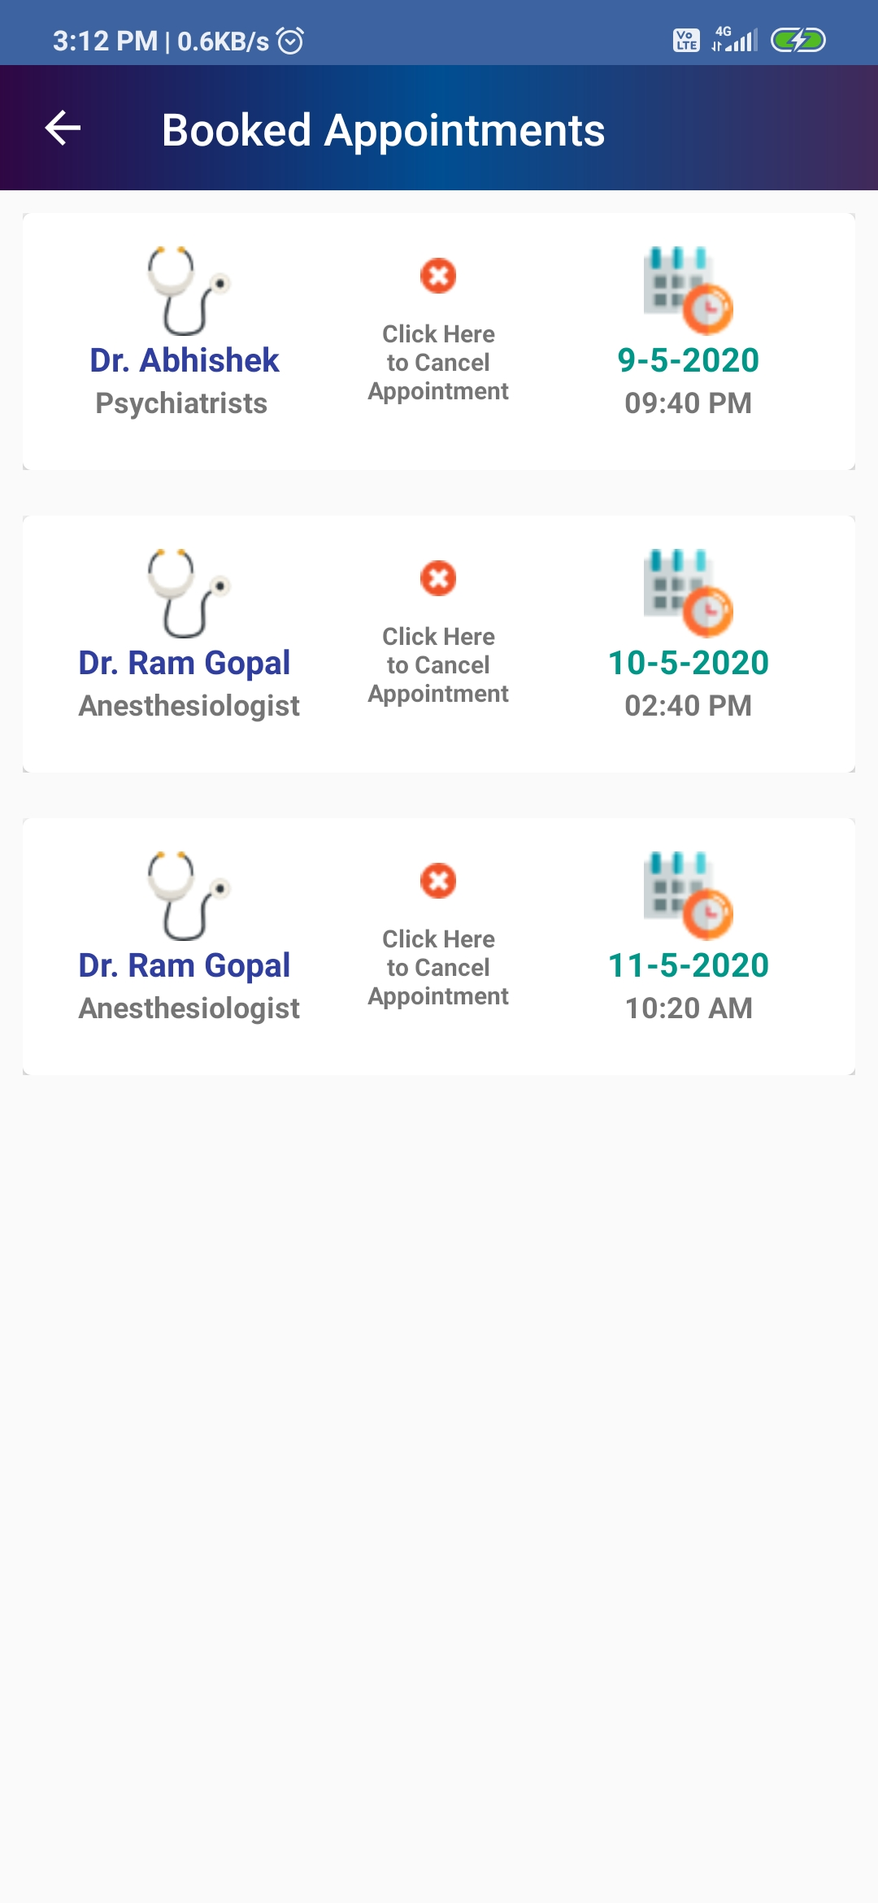
GOLDEN RULES AND HURISTICS
1. Strive for consistency in action sequence, terminology, layout, command use etc.
2. Enable frequent users to use shortcuts such as abbreviations, special key sequence and macros, to perform regular, familiar actions more quickly
3. Offer informative feedback for every user action, at a level appropriate to the magnitude of the action
4. Design dialogue to yield closure so that the user knows when they have completed the task.

Slide 11
Offer error prevention and simple error handling so that ideally users are prevented from making mistakes and if they do, they are offered clear and informative instructions to enable them to recover.
Permit easy reversal of actions in order to relieve anxiety & encourage exploration since the user knows that he can always return to the previous state.
Support internal locus of control so that the user is in control of the system which responds to his actions.
Reduce short term memory load by keeping displays simple, consolidating, multiple pages display and providing time for learning action sequences.

Slide 12
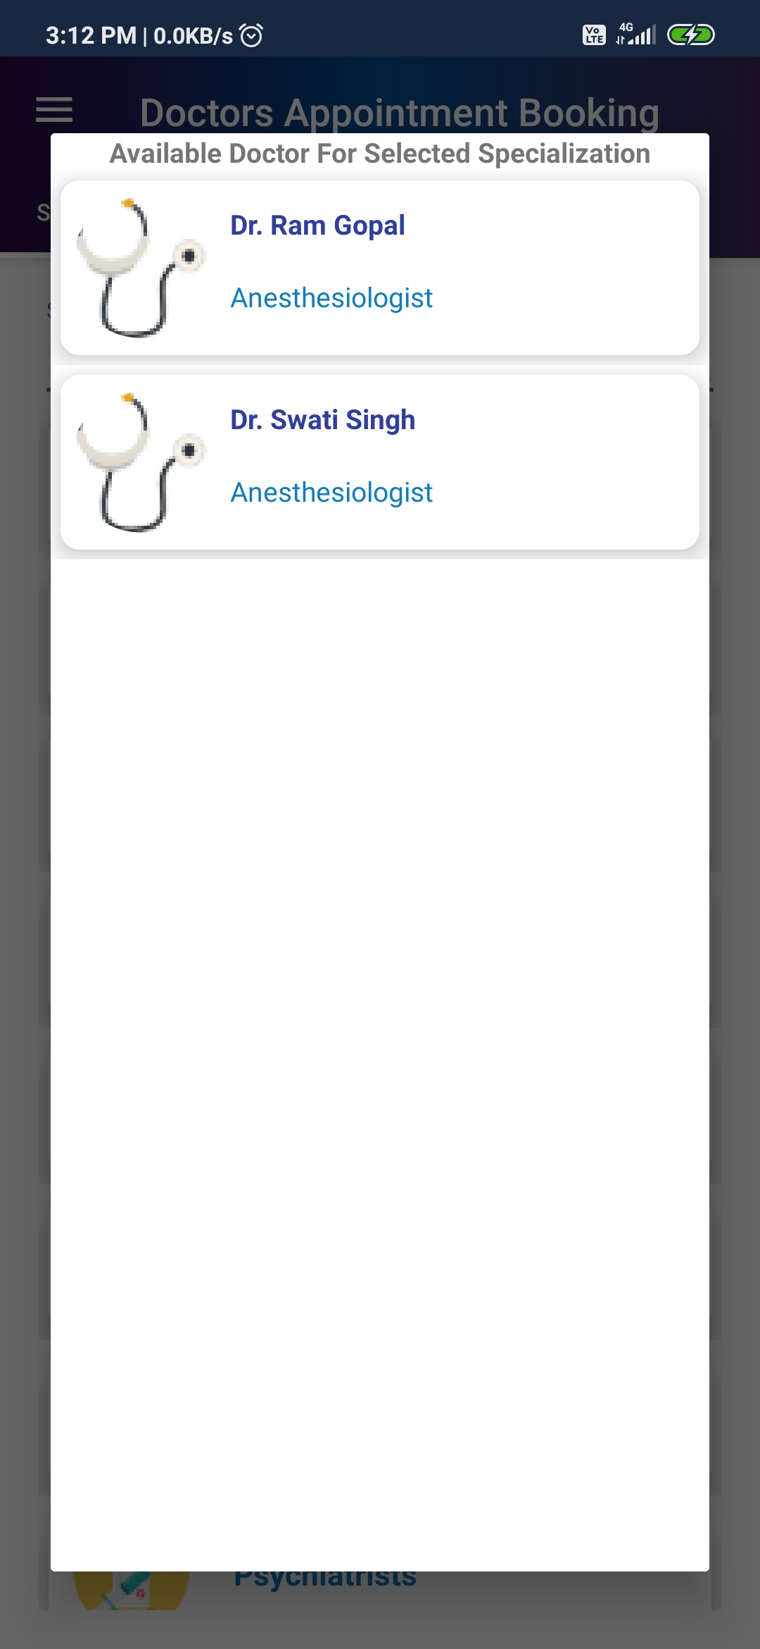
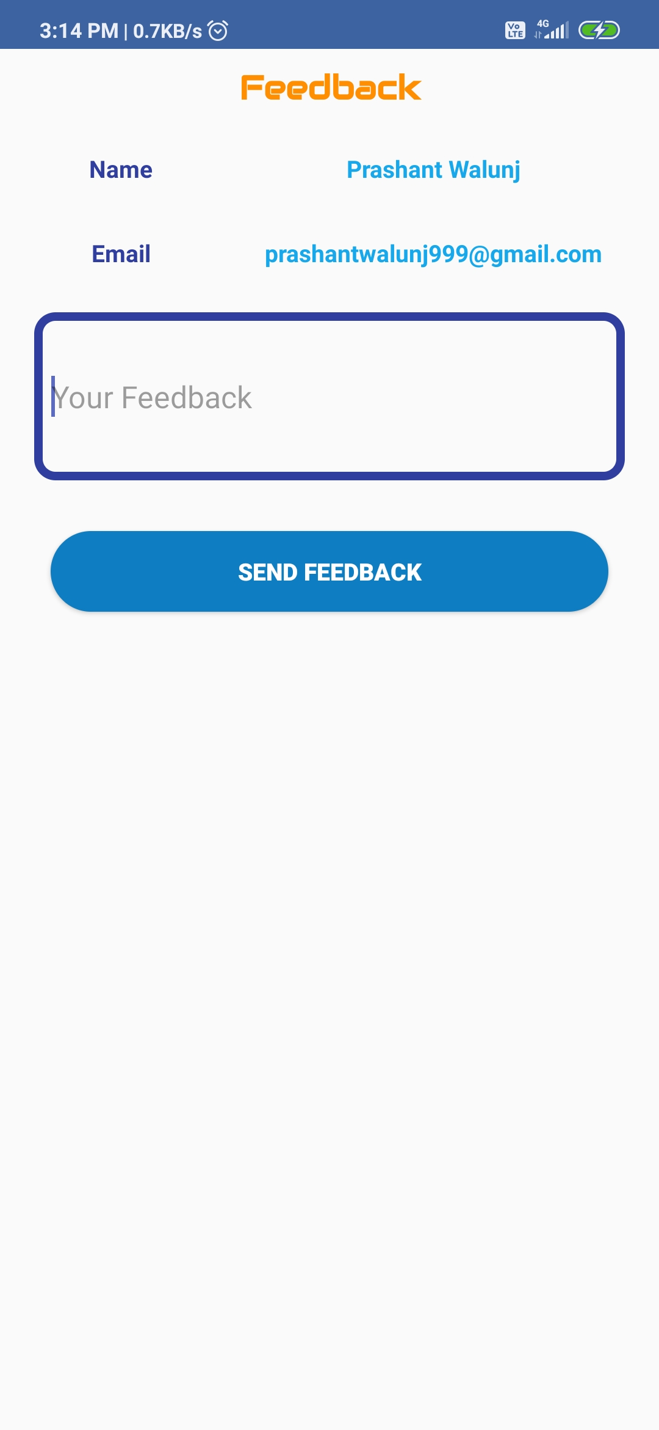

Slide 13
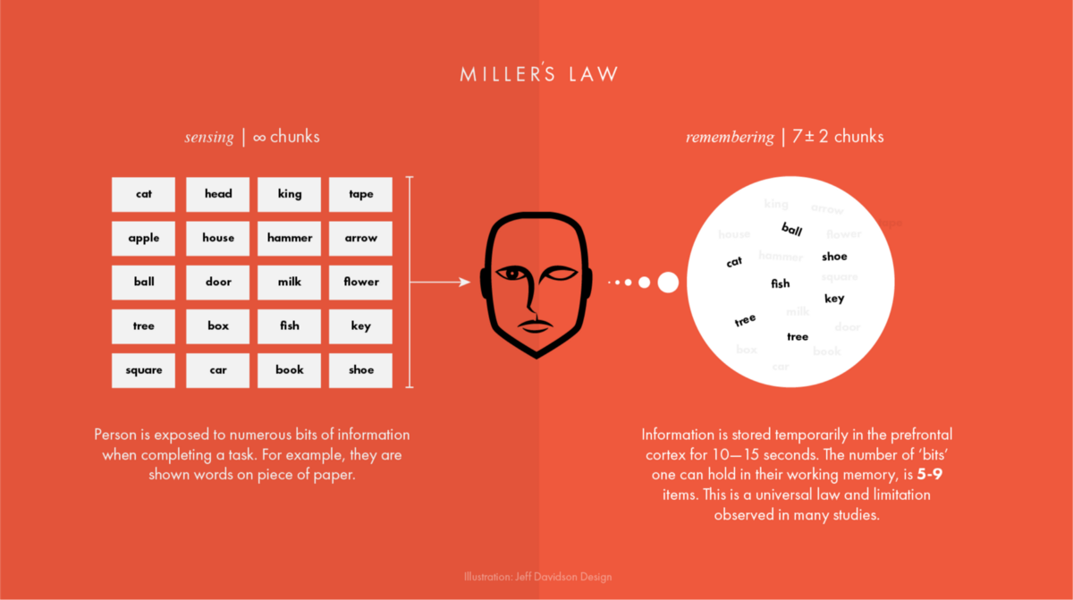
MILLERS LAW AND METAPHOR
We have consider the Millers law while designing the interface. User only have to consider 4-5 main modules while using our application.

Slide 14
DESIGN RULES:
It is easily learnable for end user.
Flexible: It is flexible application which can be access by android phone.
Reduce short-term memory load: As user don’t require to consider lot of information while accessing the app.
Permit easy reversal of actions: User can go back to previous operation by simply using back button.

Slide 15
CONCLUSION
This app provide ease and comfort to patients while taking appointment from doctors and it also resolves the problems that the patients has to face while making an appointment.
The android application acts as a client whereas the database containing the doctor’s details, patient’s details and appointment details is maintained by the server.

Slide 16
Thank you…

